Slide 1
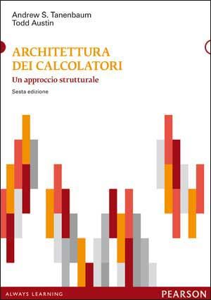

Slide 2
Architettura dei Calcolatori Un Approccio Strutturale
A.S. Tanenbaum
T. Austin
(VI Ed. – Pearson)

Slide 3
Introduction
Chapter 1:
Hardware vs Software
Approccio strutturale
Macchine Virtuali
Traduttori ed Interpreti
Programmi e Processi

Slide 4
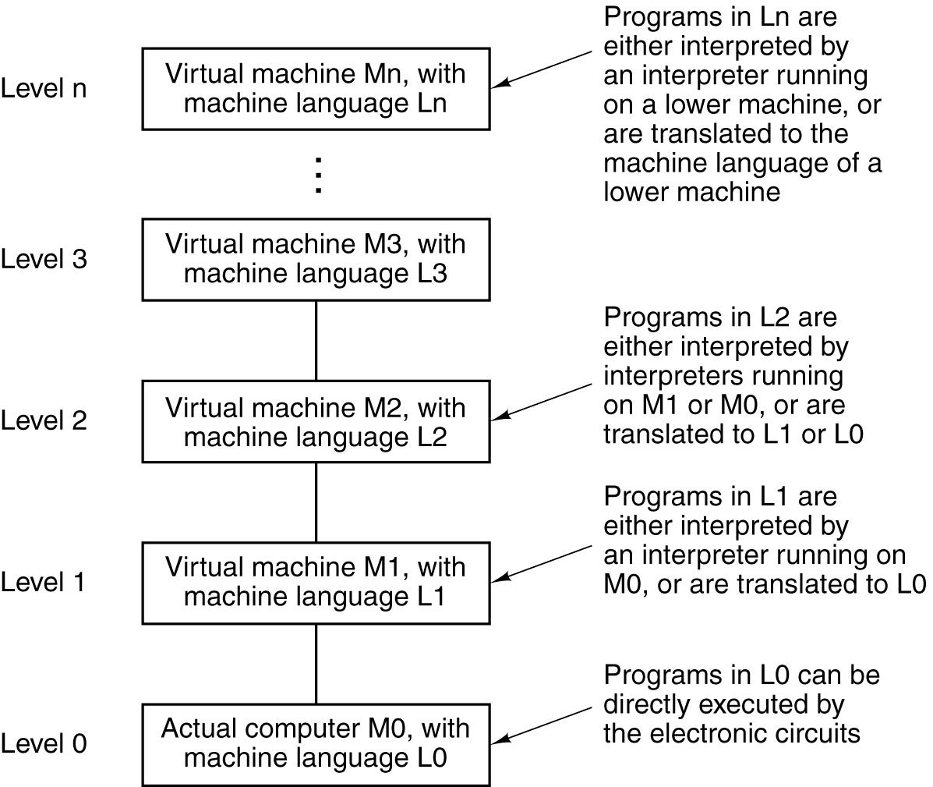
Languages, Levels, Virtual Machines
A multilevel machine

Slide 5
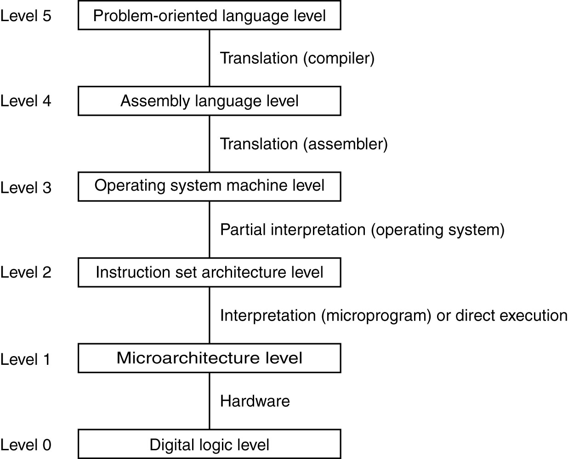
Contemporary Multilevel Machines
A six-level computer.
The support method for each level is indicated below it .

Slide 6
Contemporary Multilevel Machines
Assembler
Users: Programmatori (Traduzione)
Sistema Operativo (1960∼)
ISA Micoprogrammed (Wilkes ’51) vs
“wired logic”
ALU + registers (data path)
Users: Sistemisti (Interpretazione)
Livello logico-digitale (gate)
A six-level computer.
The support method for each level is indicated below it .

Slide 7
Evolution of Multilevel Machines
Invention of microprogramming (Wikes 1951)
Invention of operating system (IBM 1960) (chiamate di sistema, sistemi batch/time-sharing)
Migration of functionality to microcode (CISC)
Elimination of microprogramming (RISC)

Slide 8
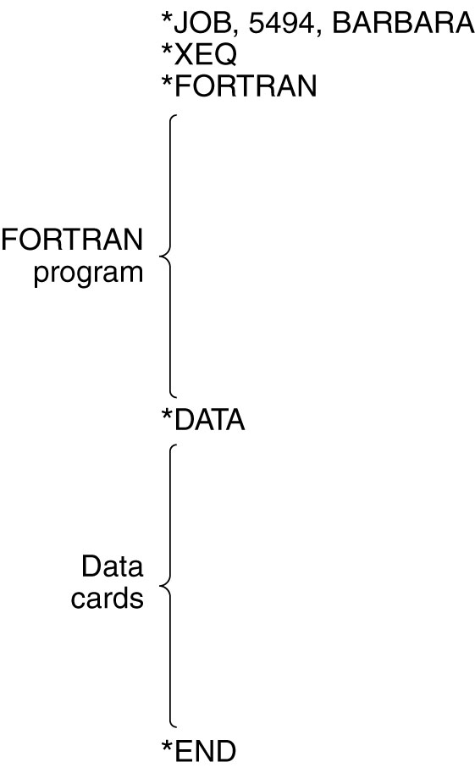
Operating System Tasks
A sample job for the FMS operating system

Slide 9
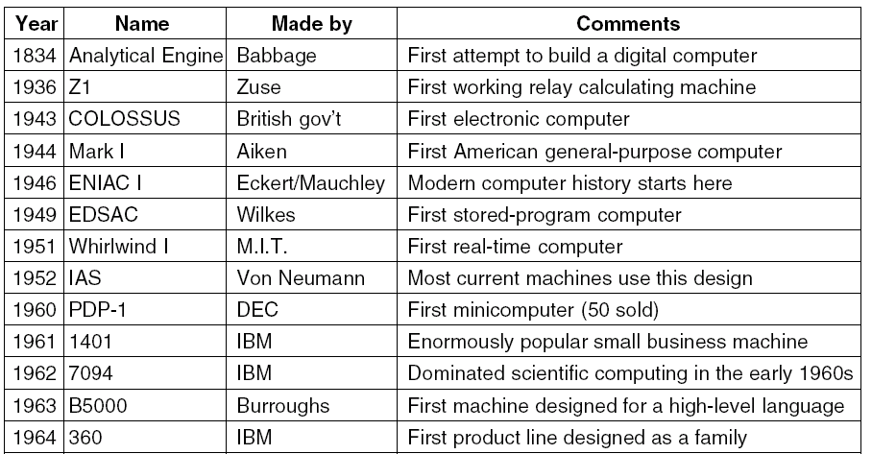
Milestones in Computer Architecture (1)
Some milestones in the development of the modern digital computer.

Slide 10
Milestones in Computer Architecture (1)
20 registri (10 cifre)
18.000 valvole
1500 relè
30 tonnellate
4096 locazioni di memoria
(40 bit ciascuna)
Programma memorizzato
Some milestones in the development of the modern digital computer.

Slide 11
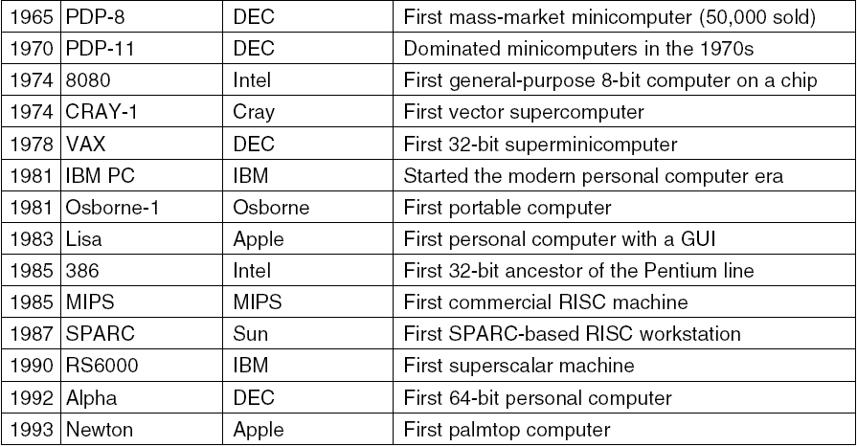
Milestones in Computer Architecture (2)
Some milestones in the development of the modern digital computer.

Slide 12
Computer Generations
0th Generation Mechanical Computers (1642 – 1945)
First Generation Vacuum Tubes (1945 – 1955)
Second Generation Transistors (1955 – 1965)
Third Generation Integrated Circuits (1965 – 1980)
Fourth Generation Very Large Scale Integration (1980 – …) (GUI, …)
Fifth Generation Pervasive Computers / Ubiquitous Computers (1990 – …)

Slide 13
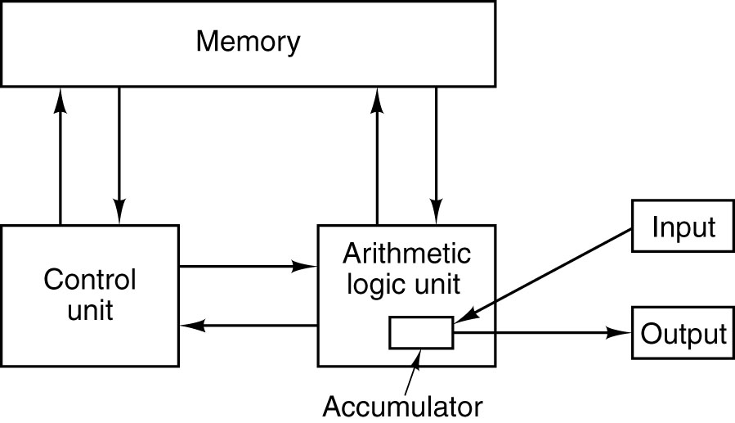
Von Neumann Machine (1952)
The original Von Neumann machine.

Slide 14
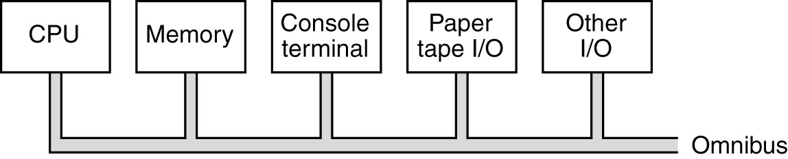
PDP-8 Innovation – Single Bus (1965)
The PDP-8 omnibus

Slide 15
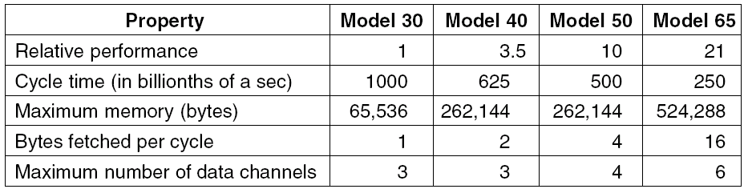
IBM 360 (1964)
The initial offering of the IBM 360 product line.

Slide 16
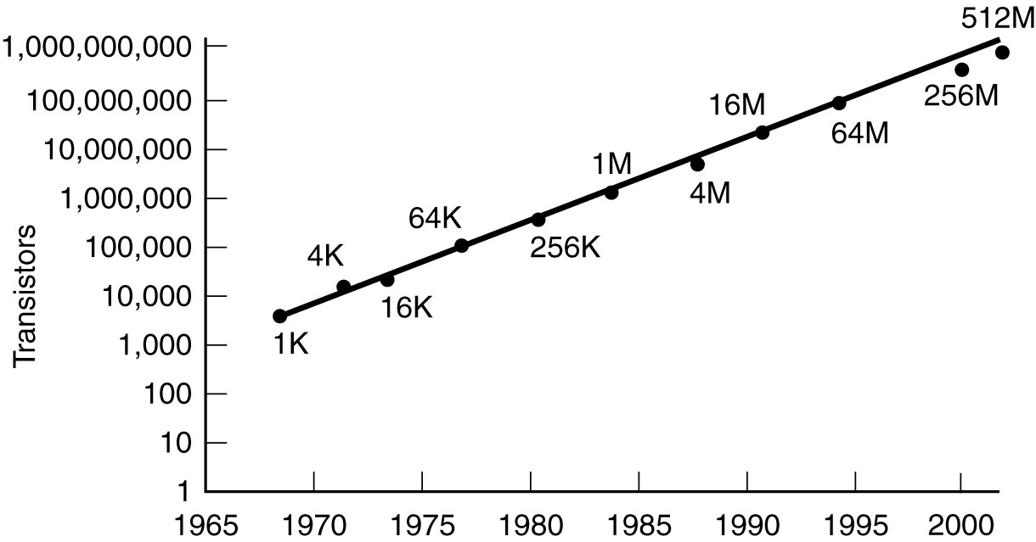
Technological and Economic Forces
Moore’s law predicts a 60-percent annual increase in the
number of transistors that can be put on a chip.
The data points given in this figure are memory sizes, in bits.

Slide 17
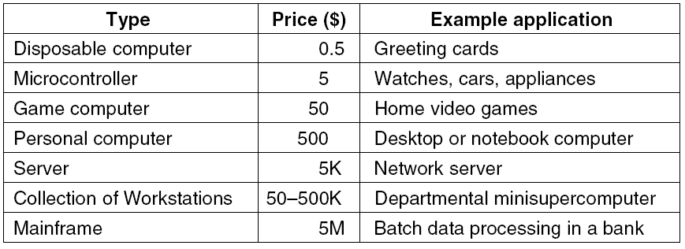
The Computer Spectrum

Slide 18
Example Computer Families
Pentium 4 by Intel
UltraSPARC III by Sun Microsystems
The 8051 chip by Intel, used for embedded systems

Slide 19
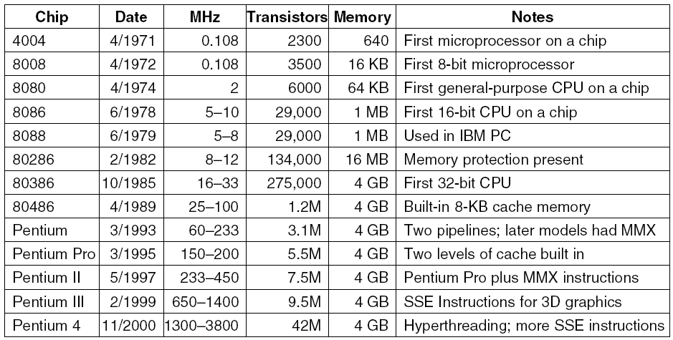
Intel Computer Family (1)
The Intel CPU family. Clock speeds are measured in MHz (megahertz) where 1 MHZ is 1 million cycles/sec.

Slide 20
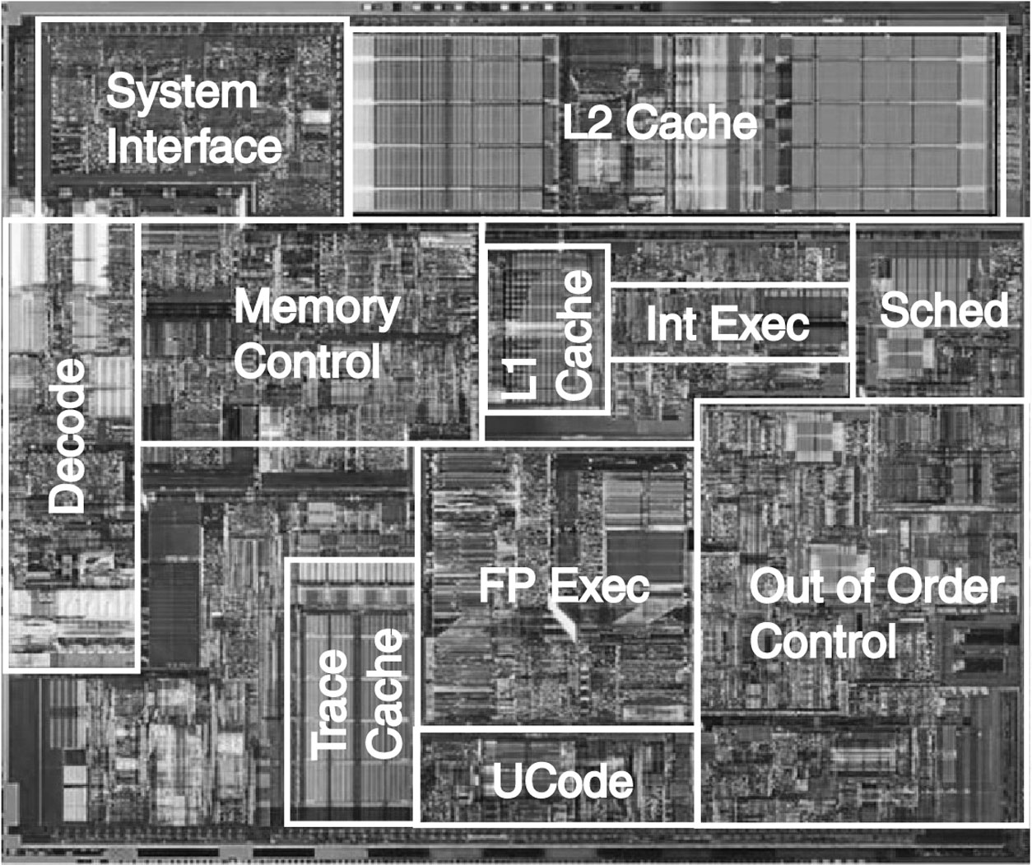
Intel Computer Family (2)
The Pentium 4 chip. The photograph is copyrighted by the Intel Corporation, 2003 and is used by permission.

Slide 21
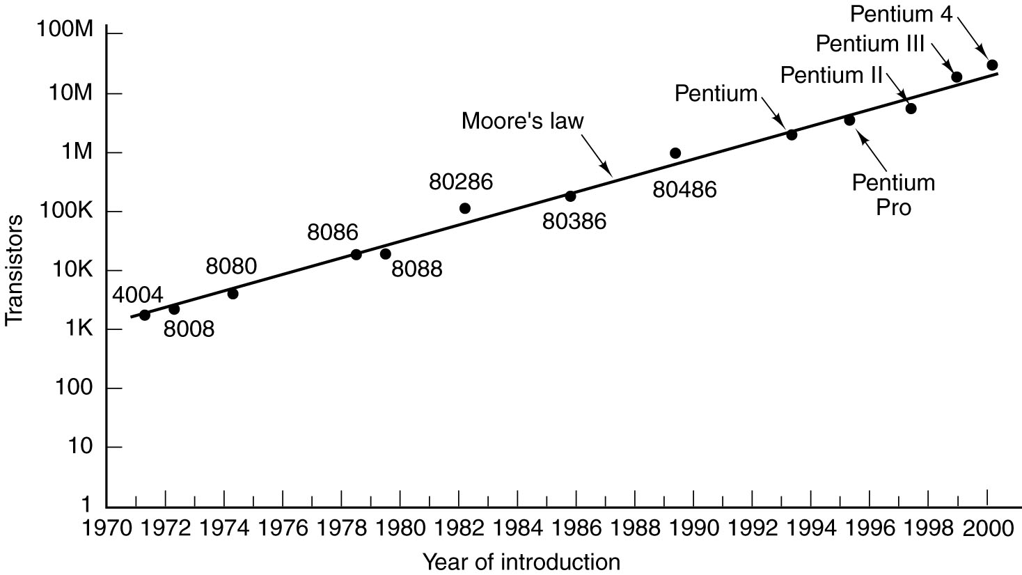
Intel Computer Family (3)
Moore’s law for (Intel) CPU chips.

